Slide 1
The State of AR & VR Hardware

Slide 2
Recent Hardware Improvements in AR & VR
Increased Convenience & Comfort
Increased XR / Mixed Reality Possibilities
Increased Social Presence

Slide 3
Inside-out Tracking
Convenience & Comfort

Slide 4
Convenience & Comfort

Slide 5
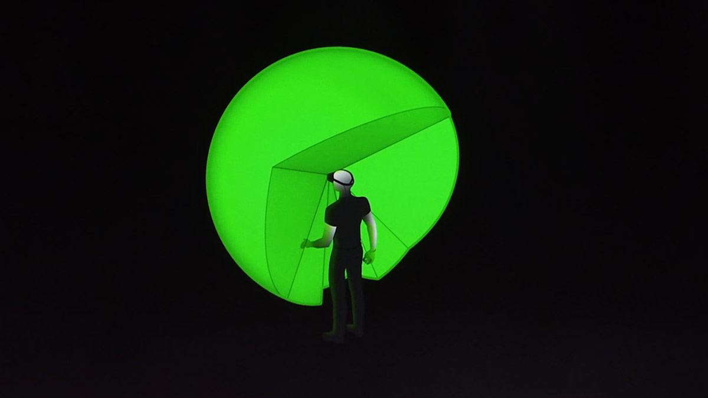
Very Wide Coverage for Inside-Out Hand Tracking
Convenience & Comfort

Slide 6
Standalone VR
Convenience & Comfort

Slide 7
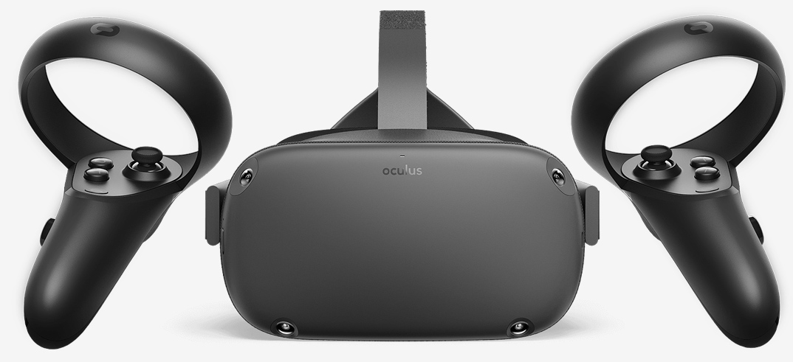
Convenience & Comfort

Slide 8
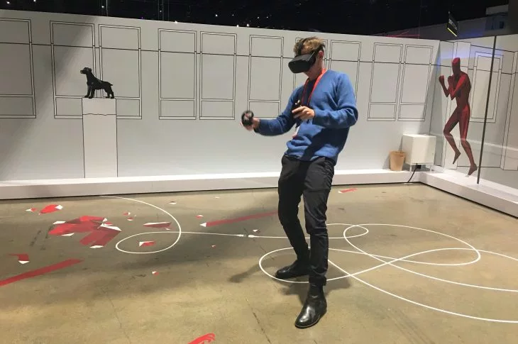
Convenience & Comfort

Slide 9
Ergonomics
Convenience & Comfort

Slide 10
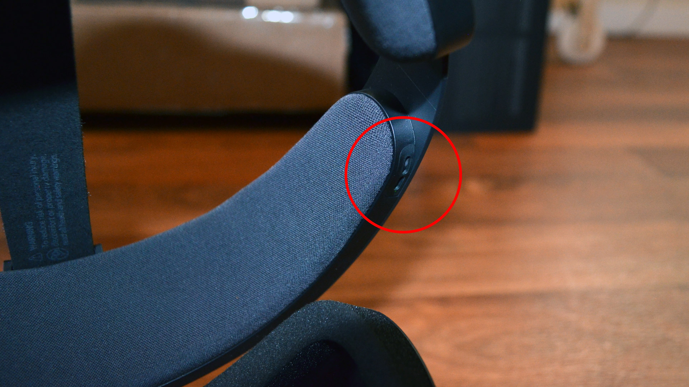
Headstrap-Embedded
Speakers
Convenience & Comfort

Slide 11
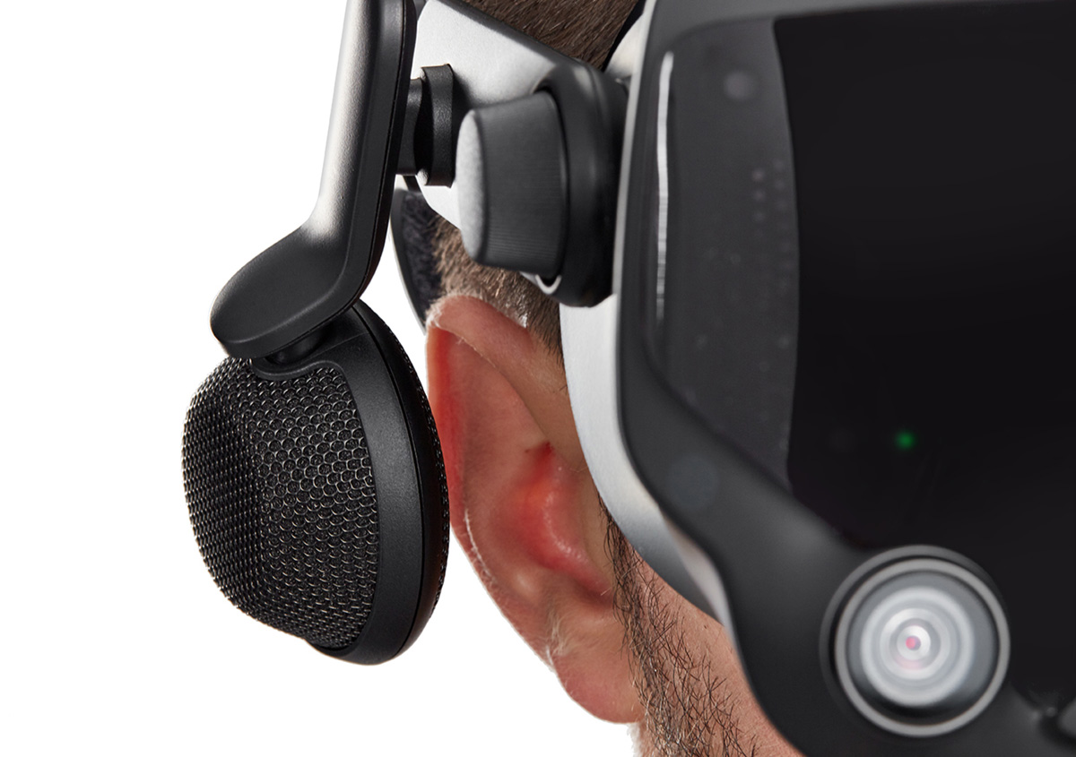
Off-Ear Speakers
Convenience & Comfort

Slide 12
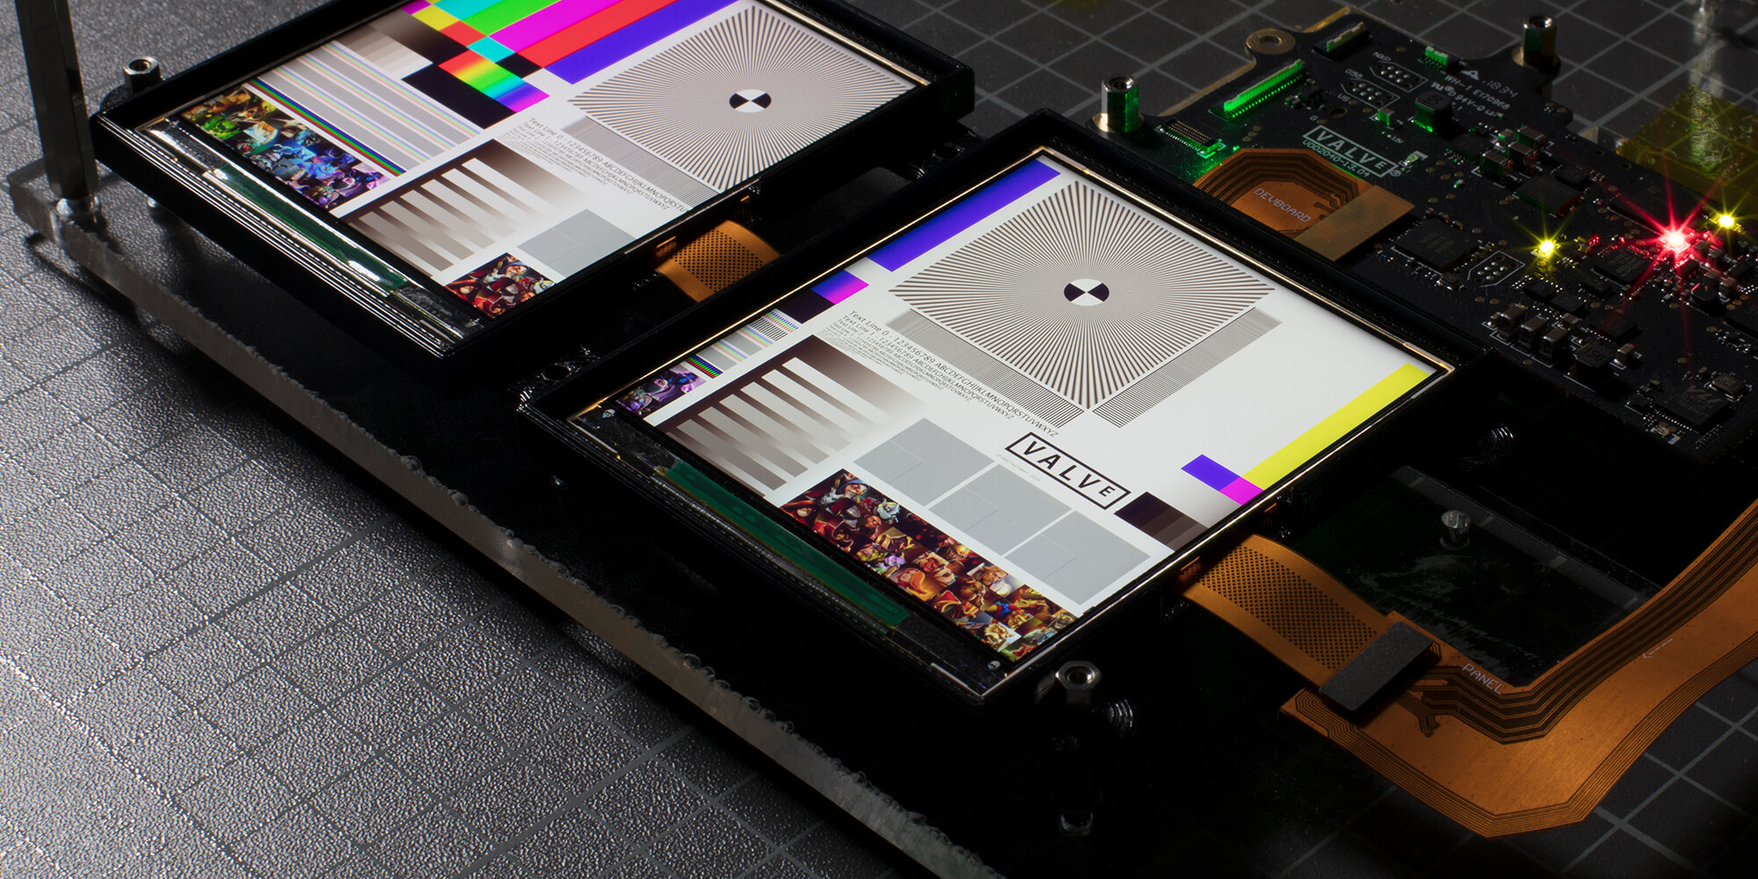
144Hz Display
Convenience & Comfort

Slide 13
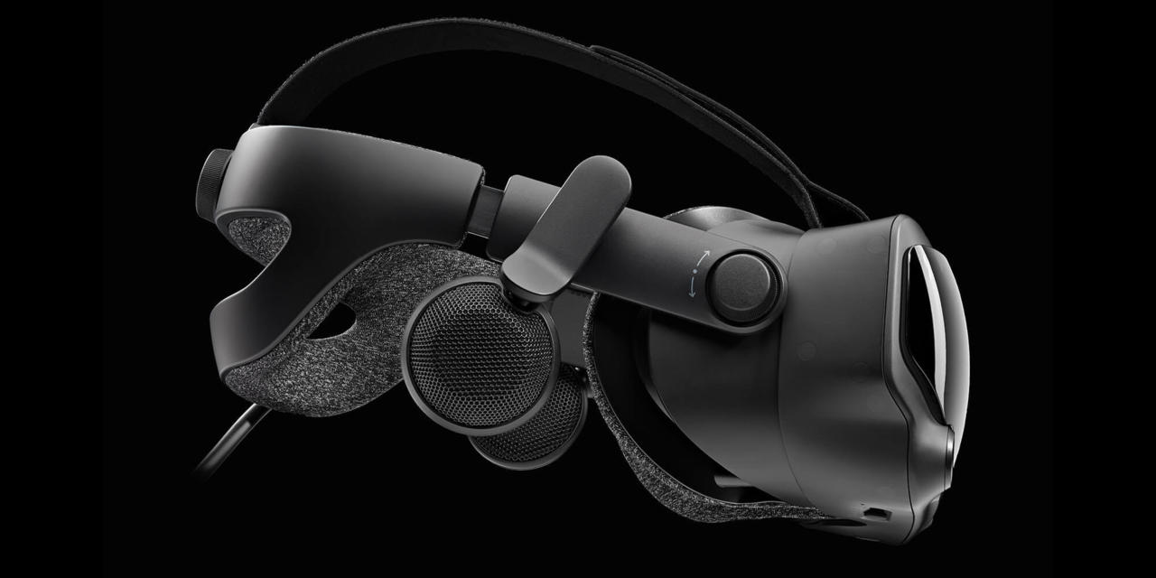
Halo-Style Headband
Convenience & Comfort

Slide 14
Adjustable Eye-Relief
Convenience & Comfort

Slide 15
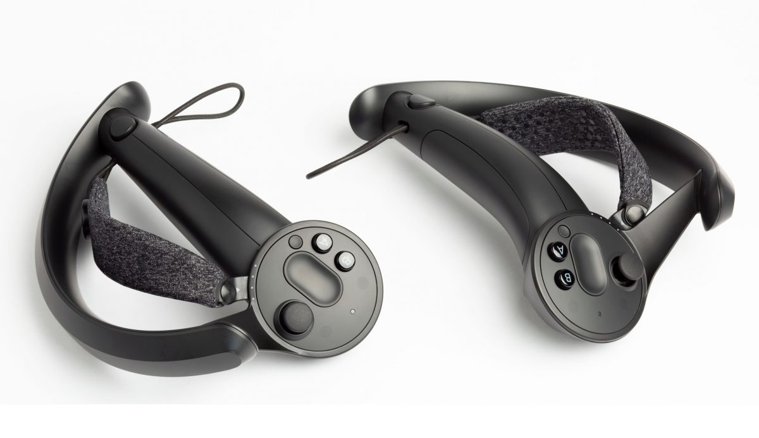
Handstrap Controllers
Convenience & Comfort

Slide 16
Recent Hardware Improvements in AR & VR
Increased Convenience & Comfort
Increased XR / Mixed Reality Possibilities
Increased Social Presence

Slide 17
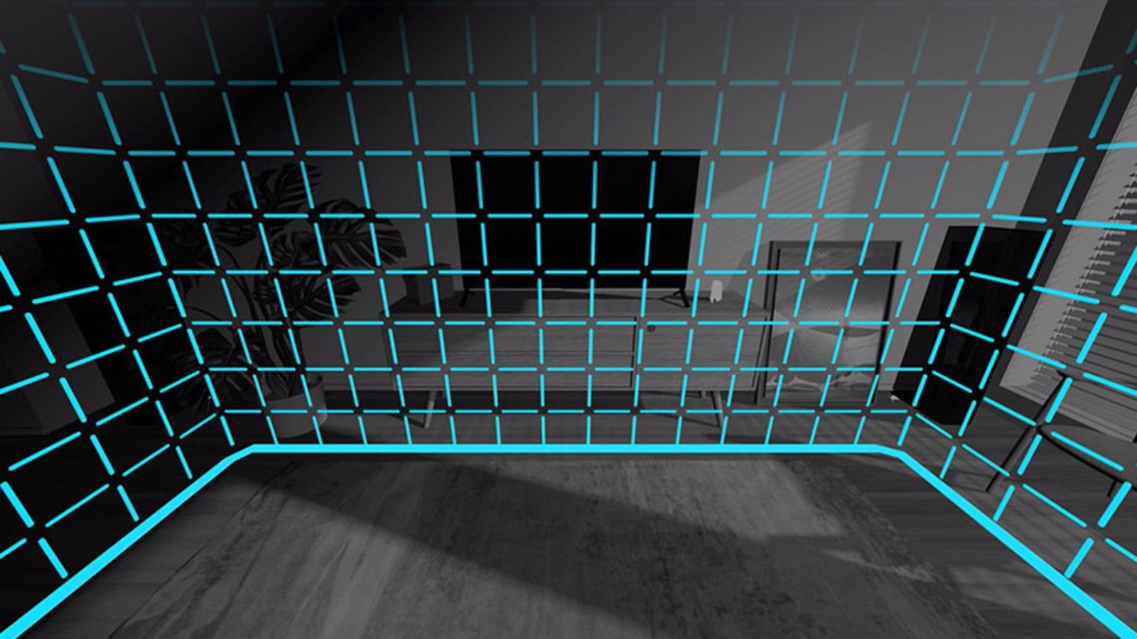
Pass-Through AR
XR Possibilities

Slide 18
Pass-Through for Hand Presence
XR Possibilities

Slide 19
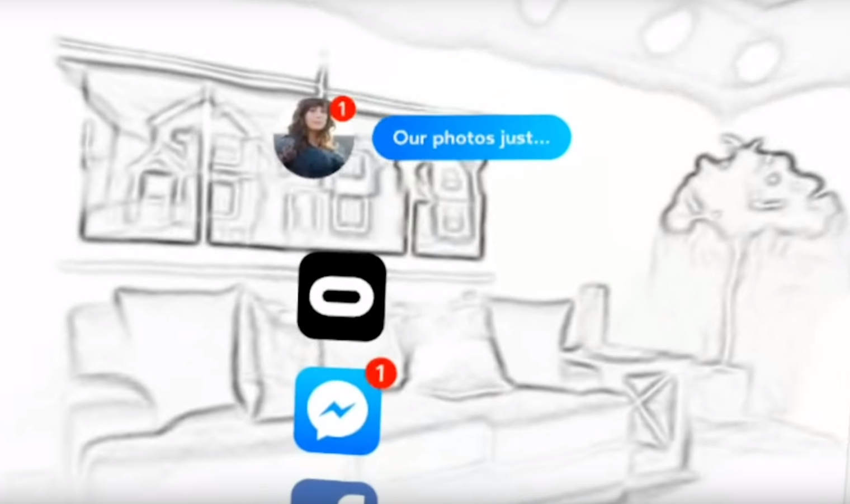
Potential for Re-Skinning
Real World Objects
XR Possibilities

Slide 20
Recent Hardware Improvements in AR & VR
Increased Convenience & Comfort
Increased XR / Mixed Reality Possibilities
Increased Social Presence

Slide 21
Hand and Finger Tracking
Increased Social Presence

Slide 22
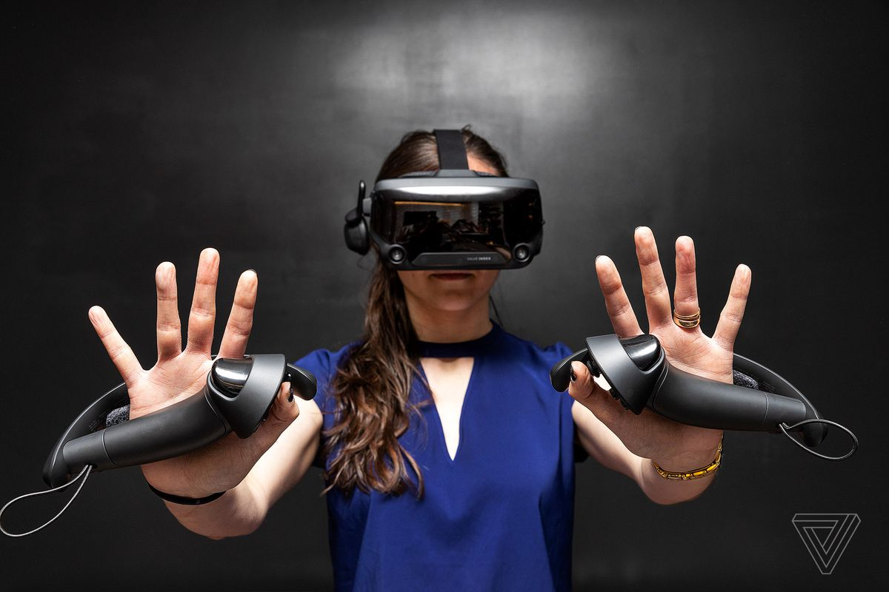
Handstrap Controllers
Increased Social Presence

Slide 23
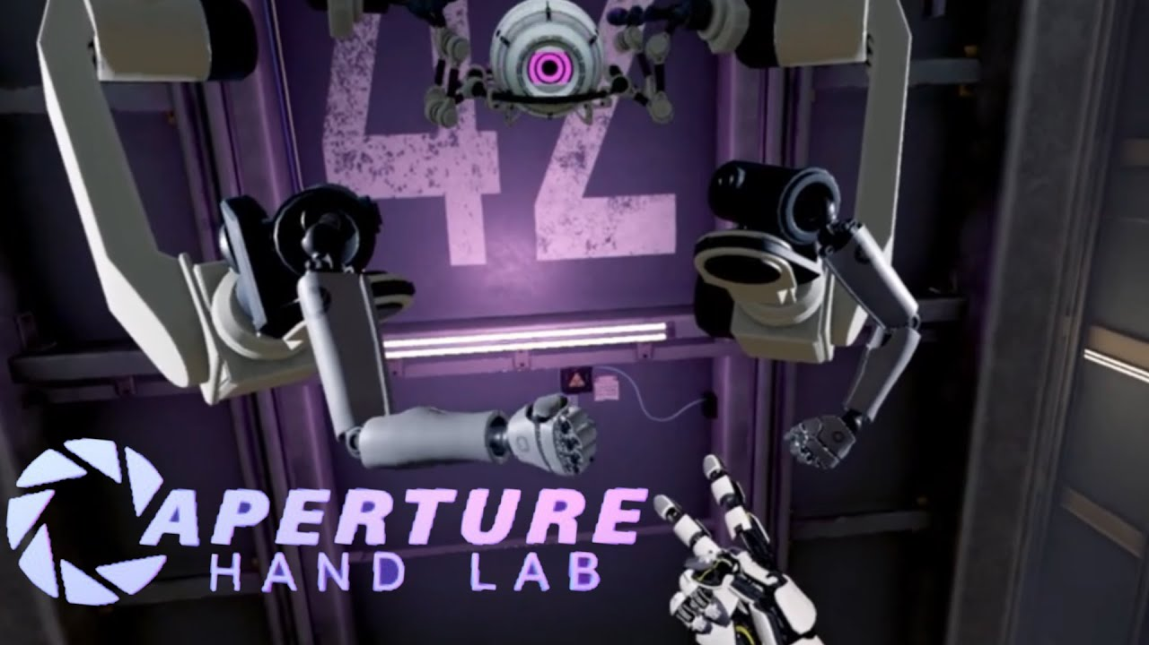
Increased Social Presence

Slide 24
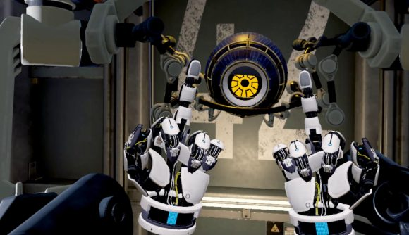
Increased Social Presence

Slide 25
Upcoming Hardware Improvements in AR & VR
Increased Social Presence
Increased Graphical Fidelity

Slide 26
Eye Tracking
Increased Social Presence

Slide 27
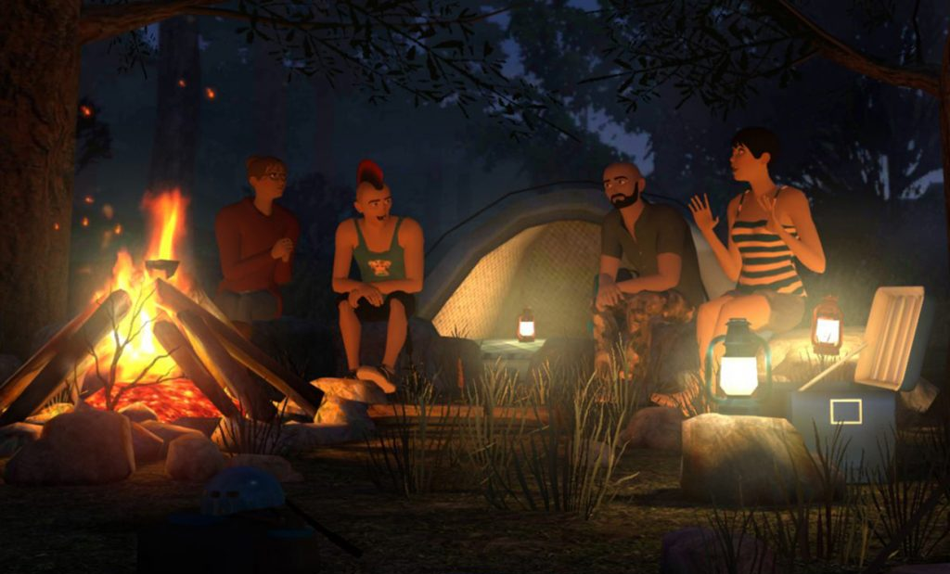
Increased Social Presence

Slide 28
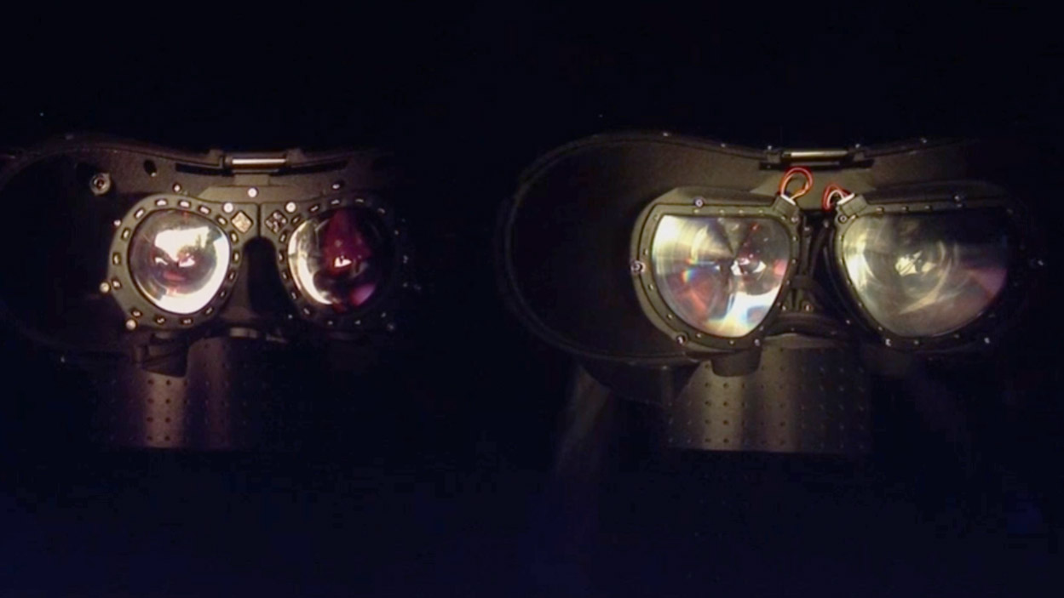
Increased Social Presence

Slide 29
Facial Tracking

Slide 30
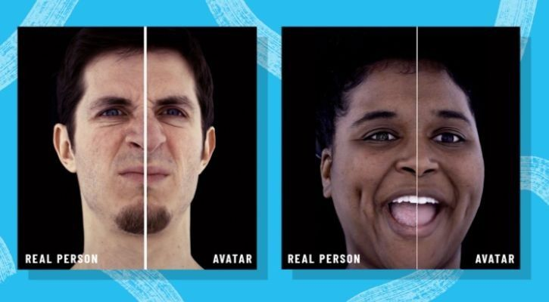
Increased Social Presence

Slide 31
Body Tracking
Increased Social Presence

Slide 32
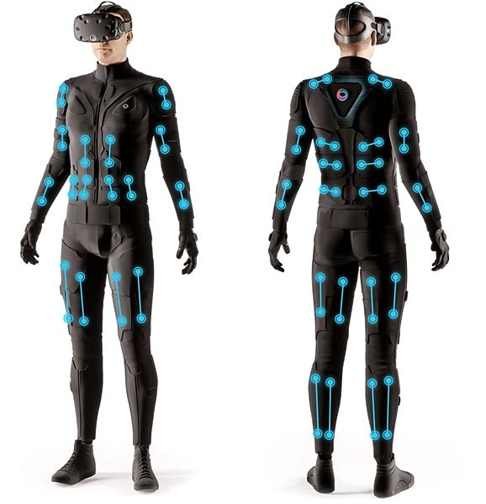
Increased Social Presence

Slide 33
Upcoming Hardware Improvements in AR & VR
Increased Social Presence
Increased Graphical Fidelity

Slide 34
Increased Resolution
Increased Graphical Fidelity

Slide 35
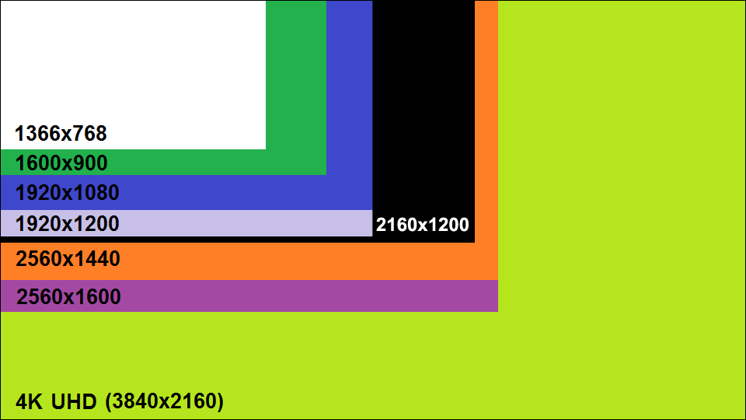
2160 x 1200
(Rift & Vive)
2880 x 1600 (Vive Pro & Samsung Odyssey)
Increased Graphical Fidelity

Slide 36
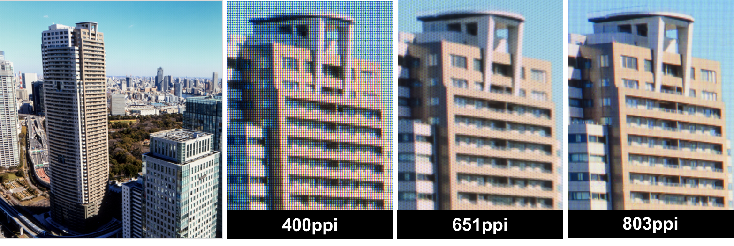
Increased Graphical Fidelity

Slide 37
Google/LG Screen vs Rift = 4.8x Linear Resolution
4.8x Linear Resolution=
23x Total Pixels
Increased Graphical Fidelity

Slide 38
Recent-history GPU efficiency increase:
3 x every 6 years
With current GPU trends, we could drive the LG / Google panel at native resolution in:
7-8 years
Increased Graphical Fidelity

Slide 39
Resolution for 20/20 vision across entire FOV is 173 million pixels.
That’s 133x what the Rift renders, and would require a GPU from 30 years in the future to drive at native resolution.
Increased Graphical Fidelity

Slide 40
Foveated Rendering
Increased Graphical Fidelity

Slide 41
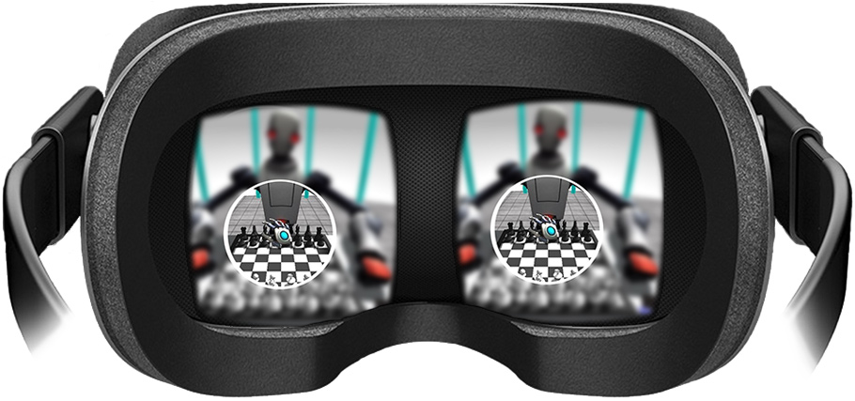
Increased Graphical Fidelity

Slide 42
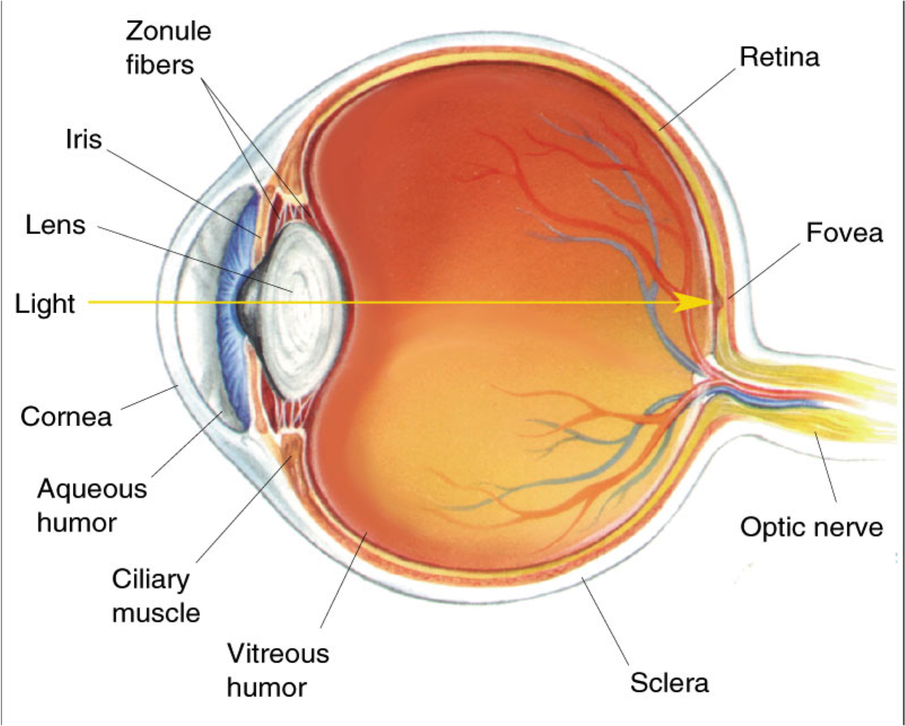
Increased Graphical Fidelity

Slide 43
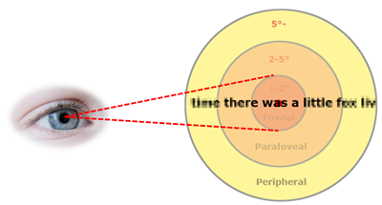
Increased Graphical Fidelity

Slide 44
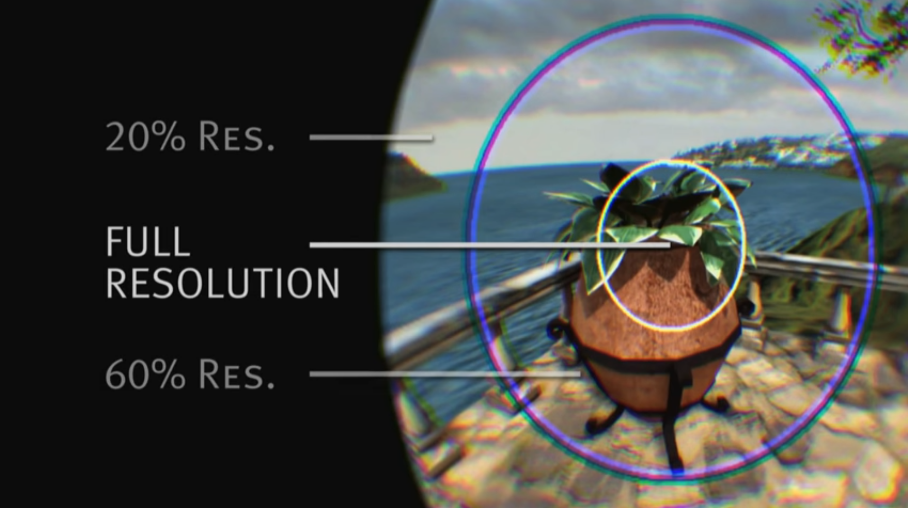
Increased Graphical Fidelity

Slide 45
Theoretical gains of 20-30x increase in efficiency are possible with near-perfect eye tracking and foveated rendering.
With perfect foveated rendering, 20/20 across the full human FOV would be possible on GPUs available in 7 - 10 years.
Increased Graphical Fidelity

Slide 46
Resolving Vergence /
Accommodation Conflict
Increased Graphical Fidelity

Slide 47
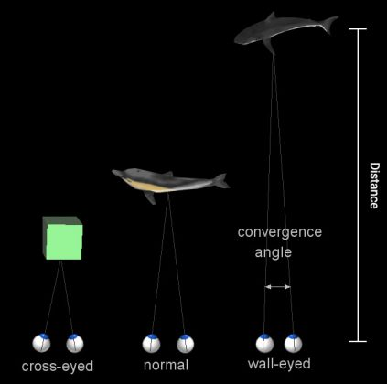
Vergence
Increased Graphical Fidelity

Slide 48
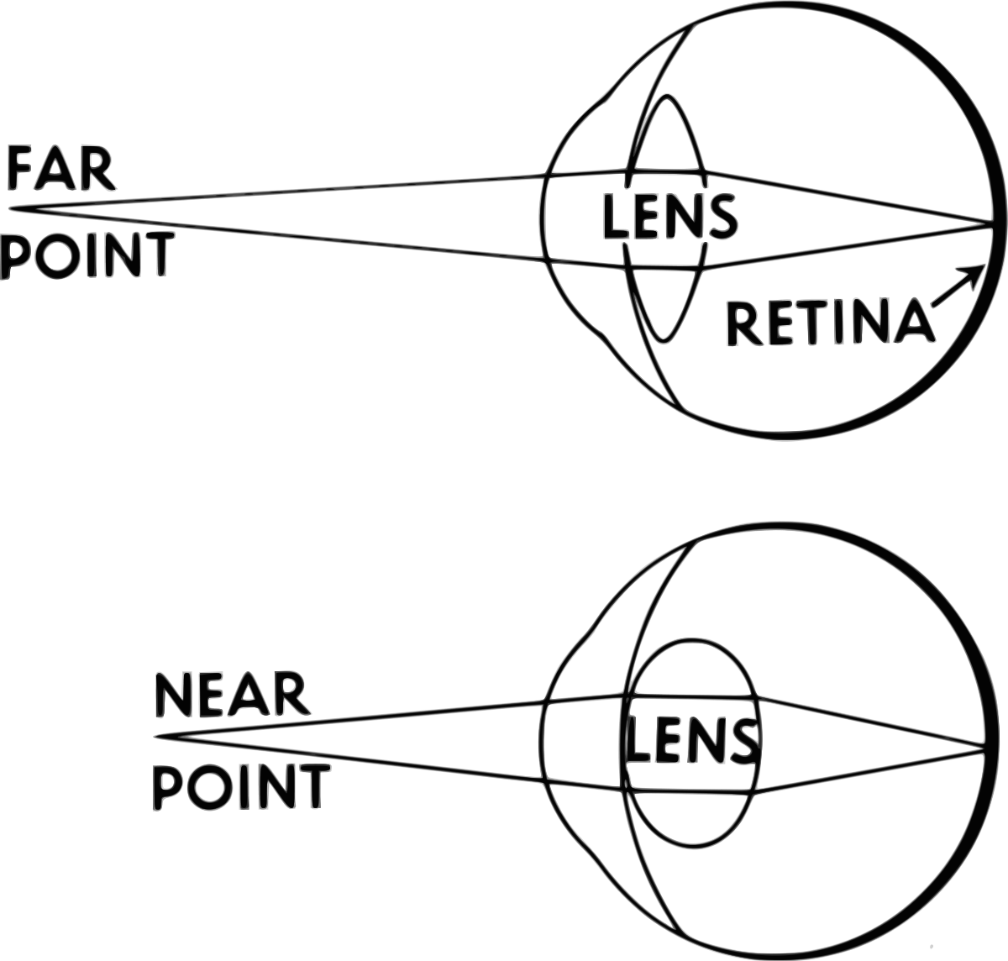
Accommodation
Increased Graphical Fidelity

Slide 49
Accommodation
Increased Graphical Fidelity

Slide 50
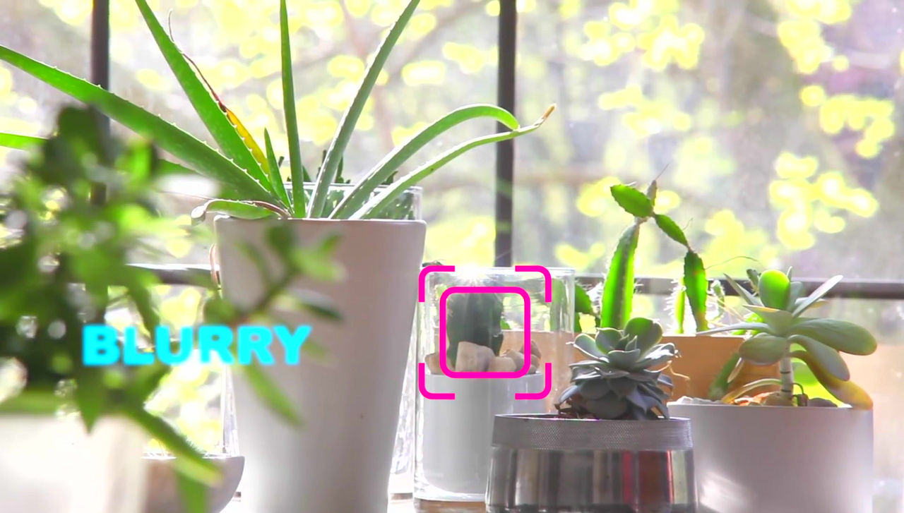
Accommodation
Increased Graphical Fidelity

Slide 51
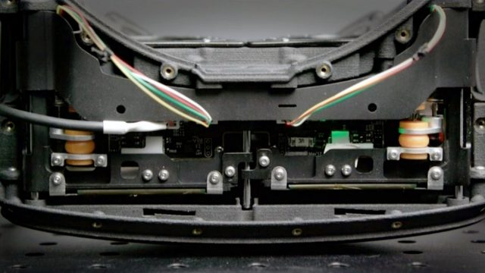
Oculus Half-Dome Prototype
Increased Graphical Fidelity

Slide 52
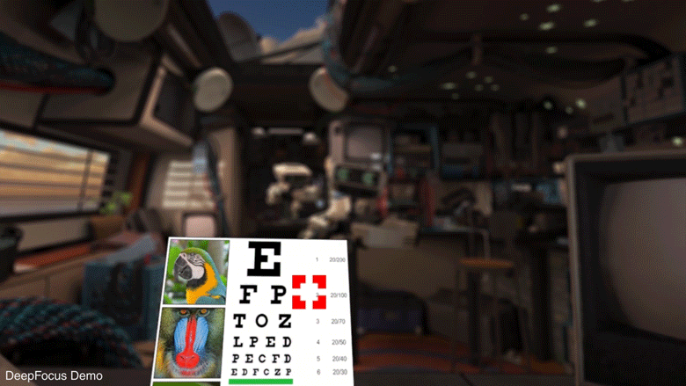
Increased Graphical Fidelity

Slide 53
Field of View
Increased Graphical Fidelity

Slide 54
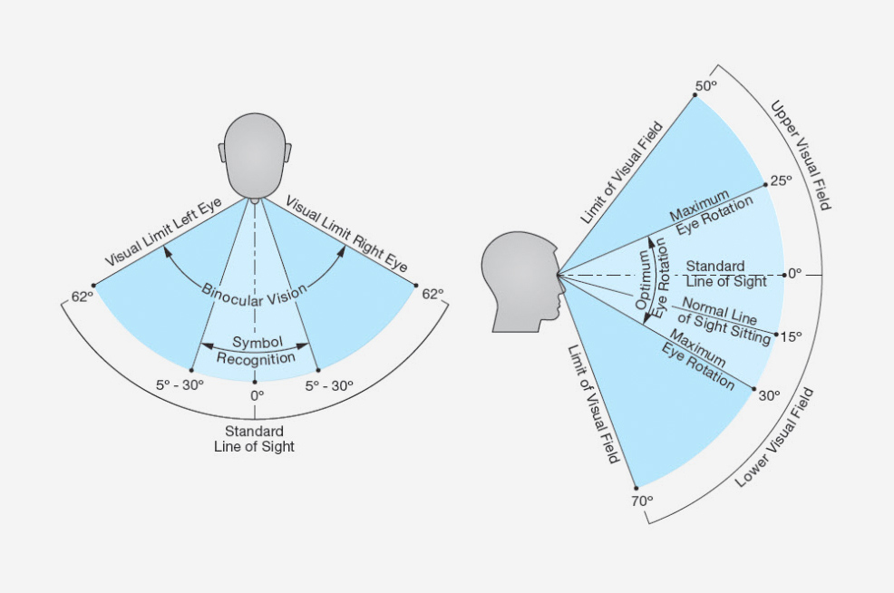
Human Vision
~120 degree binocular horizontal FOV
~200 degree monocular horizontal FOV
~120 - 150 degree vertical FOV
Increased Graphical Fidelity

Slide 55
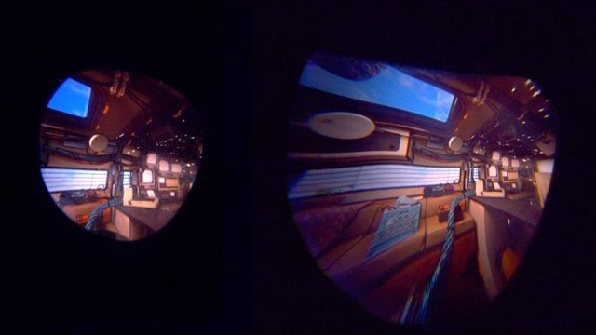
Increased Graphical Fidelity

Slide 56
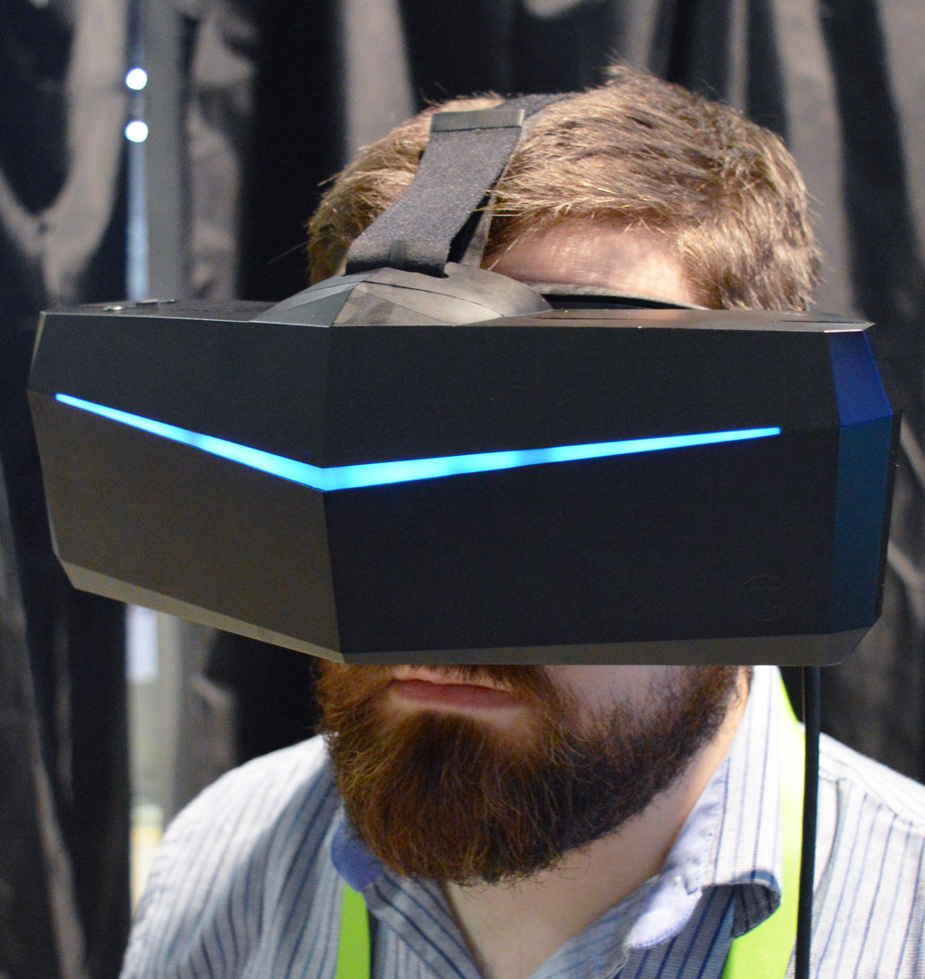
StarVR One
210 degree H FOV
Pimax “8K”
(200 degree H FOV)
Increased Graphical Fidelity

Slide 57
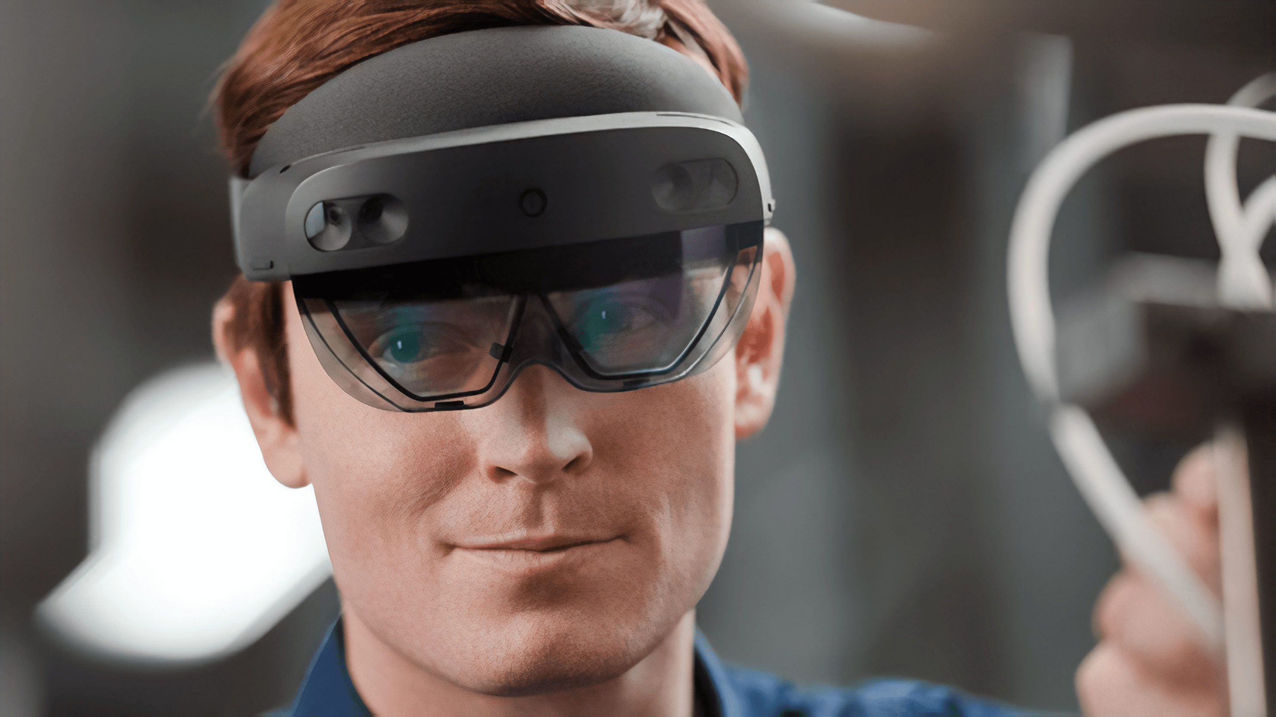
Hololens 2
Increased Graphical Fidelity

Slide 58
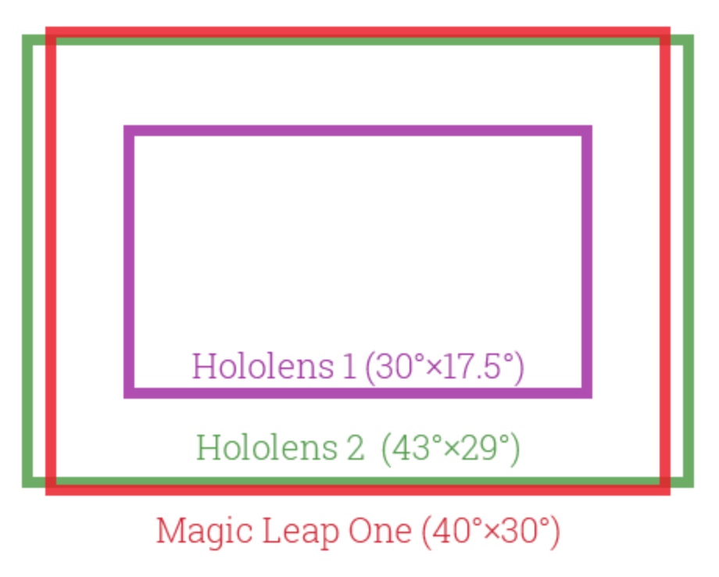
Increased Graphical Fidelity

Slide 59
Increased Graphical Fidelity

Slide 60
Increased Presence
Mental Health
Social Interaction
Increased Convenience & Comfort
Fewer barriers to use
Longer use sessions
XR Functionality
Less Local Isolation
Increased Practical Usability
Eric Liga
HoustonVR
eric@houstonvr.com

