Slide 1
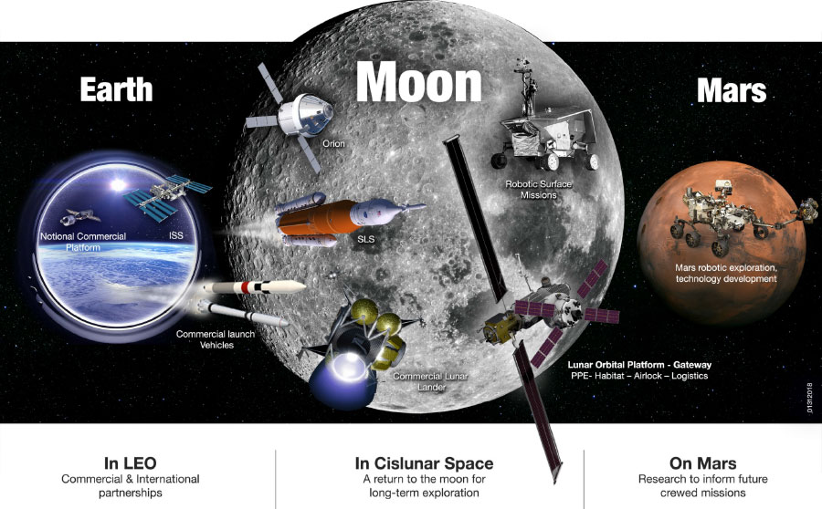
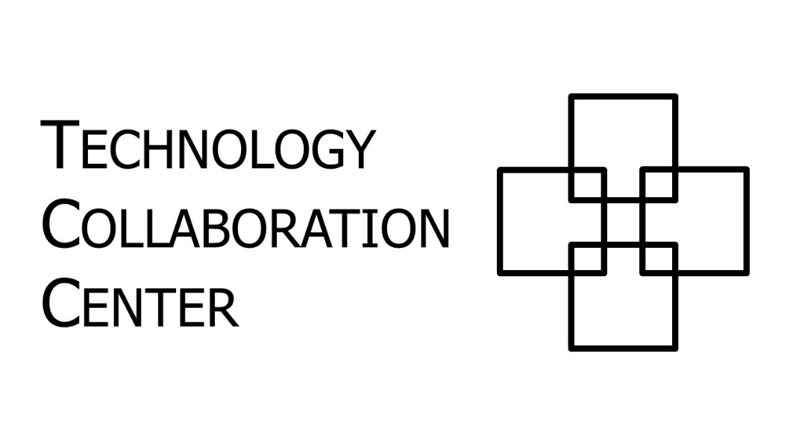
Bob Prochnow, Technology Collaboration Center Executive Director

Slide 2
TCC Background
Originally planned to help NASA form new technology partnerships
Expanded to serve all industries/technology sectors
Launched in 2015 with Space Act Agreement
Current programs:
Workshops – usually on cross-sector technology topics
OnSite Seminars – custom seminars for TCC member organizations
Collaboration Concierge Service: help find solution/partner for specific technology problem
Strategic Challenge Service: long-term partnerships for major cross-sector technology problems

Slide 3
Previous TCC Workshops
Air Quality (2015), AR/VR (2018), Additive Manufacturing & Advanced Materials (2017), Advanced Manufacturing & Carbon Materials (2018), Automation & Robotics (2017), Connected Devices & Remote Sensing (2019) Data Analytics (2017, 2019), EVA Technologies (2017, 2019), Knowledge Management (2015), Omics (2017), Precision Medicine (2018), Radiation (2016), Remote Sensing (2016), Robotics & Automation (2019), Small Launch Vehicles (2018 in El Segundo), Wearable Technologies (2016, 2018, 2019)

Slide 4
Upcoming TCC Workshops
October 23: Water Quality & Purification*, hosted by Ecolab
November/December: Imaging*
February 2020: Exploration EVA, in partnership with NASA Johnson Space Center
March 2020: Climate Change/CO2 Reduction, hosted by Rice University
April 2020: Wearable Technologies (including university challenge program)
* = includes afternoon Strategic Challenge sessions

Slide 5
Strategic Challenge Service
New program for 2019
TCC assists in forming long-term partnerships to develop solutions to strategic technology challenges
4 pilot projects are being launched:
Water @ October 23 workshop
Imaging @ November/December workshop
Automation (2020)
Resilient & Renewable Energy (2020)

Slide 6
Current Membership
Full Members (Board representatives underlined):
Ecolab, Greater Houston Partnership, Jacobs, KBR, NASA, NASA Johnson Space Center, Schlumberger, Shell
Partner Members:
Baylor College of Medicine, Rice University, Texas A&M System, Texas A&M-Corpus Christi, Texas A&M Engineering Experiment Station (TEES), Texas A&M-Kingsville, University of Houston, University of Houston-Clear Lake, University of Texas at Dallas, University of Texas MD Anderson Cancer Center
Community Members:
Aexa Aerospace, Austin Technology Incubator, Bay Area Houston Economic Partnership, BayTech, Danish Aerospace Company-North America, DLZP Group, Energy Conference Network, Houston Exponential, Houston Spaceport, Innovenate, ISS National Lab, METECS, Revision Military, Rice Space Institute, Ringers Gloves, Scottish Development International, SpaceCom, Starburst Accelerator, Strategic Sensing Alliance, Streamline Chemical, UK Science & Innovation Network-British Consulate General-Houston, Xofia
47 Individual Members (who get 50% discount on workshop tickets)

Slide 7
For more information:
techcollaboration.center
bob.prochnow@techcollaboration.center
281-969-7801

