Slide 1
GOLD-2 – Anticipating Customer Needs
August 2019
Presented by: Carl Walz
THIS DOCUMENT DOES NOT CONTAIN ANY EXPORT CONTROLLED TECHNOLOGY OR TECHNICAL DATA

Slide 2
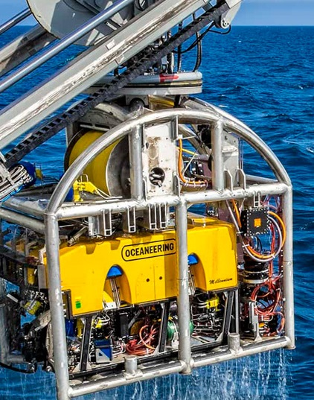
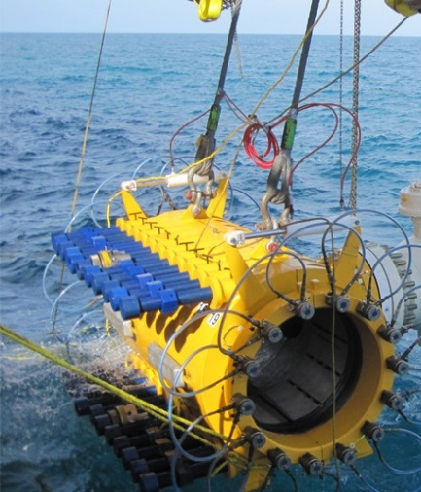
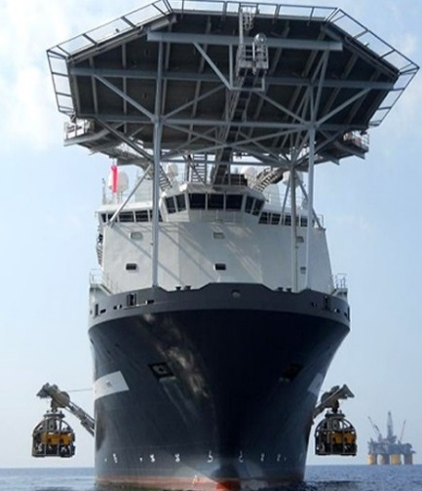
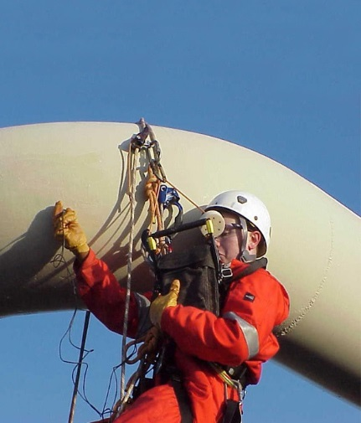
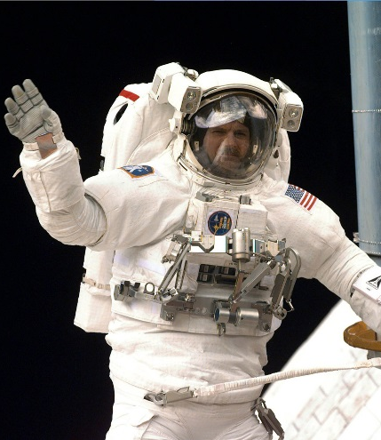
Oceaneering International, Inc.
Worldwide Marine and Engineering Services and Solutions
Oceaneering’s fleet of Remotely Operated Vehicles (ROVs) operates in the depths of the world’s oceans for the energy industry
Oceaneering’s production facilities build subsea hardware and fleets of robotic vehicles for the energy, automotive, logistic, and entertainment industries
Oceaneering’s Advanced Technology group provides products and services for the military, civil and commercial markets
ROV
Subsea Products
Subsea Projects
Asset Integrity
Advanced Technologies
Notes:
Oceaneering is an engineering and services company. Our work has made it one of the world leaders in robotic systems supporting energy, automotive, logistics, entertainment, and space industries.

Slide 3
Anticipating Customer Needs
Previous Model – Meeting Customer Needs
Normal Aerospace business development involves searching for defined opportunities to bid on
We search FedBizOps
We field calls from Primes to bid on a government job for them or with them
The RFPs describe the customer needs, and the applicable requirements
In the past, most of the jobs were cost plus
In recent years, NASA has adjusted their approach to some procurements
Spur commercial demand in Low Earth Orbit
Commercial Orbital Transportation System
Incorporate commercial terms
Emphasize more fixed price jobs

Slide 4
Anticipating Customer Needs
GOLD-2 Payload Latching Device Story
There are a limited number of legacy payload connectors for the attachment of science instruments or technology development projects outside of the International Space Station.
Those legacy systems are expensive and can be large
For commercial payload facility operators, a small, affordable payload attachment system was needed that met all the requirements of human space flight systems at the price point that our customers could accept.
In 2015, Oceaneering developed and delivered a payload latching device concept for a commercially operated payload facility on the ISS
In 2016, Oceaneering conceived the General-purpose Oceaneering Latching Device 2 (GOLD-2), sized to handle larger payloads and designed for the rigors of space.
Space environment includes large temperature changes, atomic oxygen, space radiation,
Operate reliably and consistently to support planned and unplanned operations on the ISS and other space platforms.
Oceaneering provides a turn-key approach to our customers to develop the hardware, and provide NASA sign off authority for stress, thermal analysis, and quality.

Slide 5
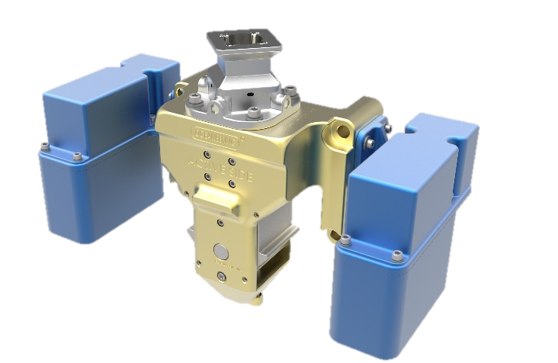
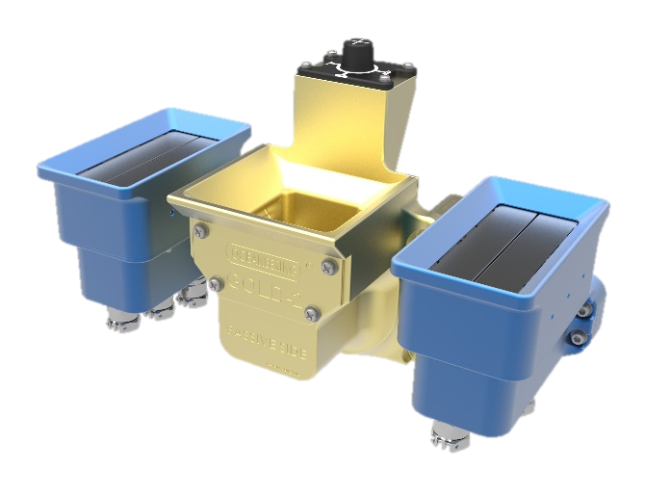
GOLD-2 Payload Latching Device
GOLD-2 Connector is scaled from another flight proven connector to:
Accommodate Micro-square Fixture with anti-rotation feature
Accommodate EVA kick loads for a 1m³ ORU and ISS acceleration of 0.2g for up to 454 kg (1000 lb) payload
Connector can accommodate multiple electrical connectors and/or fiber optic connectors
Design includes feature to separate active and passive sides during de-mate to minimize pull forces
Mass
Active Side: 3.5 kg (7.8 lb)
Passive Side: 4.3 kg (9.4 lb)
Active Side
Passive Side
GOLD-2 Connector with two Electrical Connectors

Slide 6
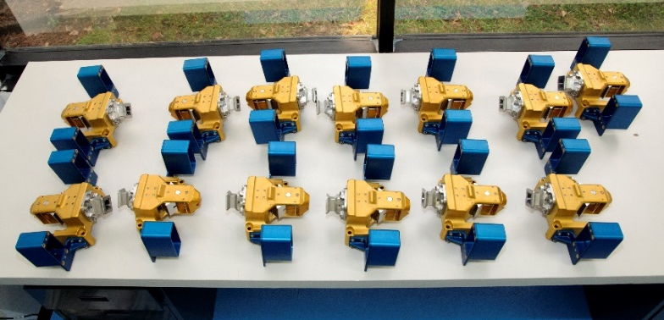
Anticipating Customer Needs
GOLD-2 Payload Latching Device Story
As Oceaneering began the development of GOLD-2, we became aware of Airbus’ need for a payload latching device
Oceaneering and Airbus connected at the ISS R&D in 2016
Began a business conversation that finally solidified in a FFP contract for multiple latching devices in 2018 for the Bartolomeo platform
Through Airbus, Oceaneering and NanoRacks discussed how the GOLD-2 could meet NanoRack’s needs for their new Bishop Airlock
Began a business conversation that also solidified a FFP contract for multiple latching devices
GOLD 2 Flight Production Units

Slide 7
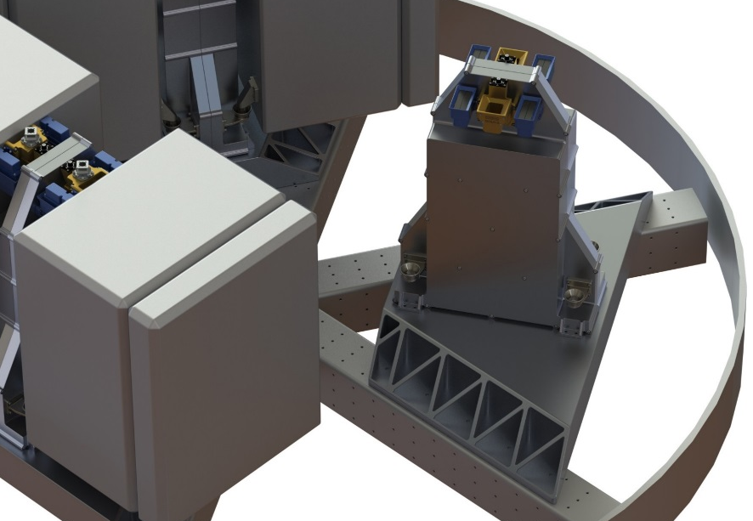
Anticipating Customer Needs
The Next Chapter
Oceaneering is working with its customers and partners to commercially develop a flight support structure for use on ISS resupply flights
External payloads launch externally
No need to compromise payloads; for example, by having to remove satellite propellants
Reduce the need for payload handling by NASA astronauts
Reduce the need for ISS airlock cycles

Slide 8
Contact: Carl Walz, cwalz@oceaneering.net
281-228-5395
Michael Withey, mwithey@oceaneering.net
Jerry Ryzewski, jryzewsk@Oceaneering.net

