Slide 1
LEO Economic Development
Strategy Overview & Near Term Plans
Marybeth Edeen
June 25th, 2019

Slide 2
Goals for Human Spaceflight in LEO
It is the sense of Congress that “an orderly transition for United States human space flight activities in low-Earth orbit from the current regime, that relies heavily on NASA sponsorship, to a regime where NASA is one of many customers of a low-Earth orbit commercial human space flight enterprise may be necessary.” P.L. 115-10, NASA Transition Authorization Act of 2017
The President’s 2020 Budget: Drives toward a Vibrant, U.S.-Led Economy in Earth Orbit. The Budget provides funding for the International Space Station as well as for new commercial space capabilities that will facilitate a transition to a more robust and cost-effective approach to human space activities near the Earth. By 2025, the Budget envisions commercial capabilities on the International Space Station as well as new commercial facilities and platforms to continue the American presence in Earth orbit.
Four goals from Oct 2018 NASA/Commerce/State report to the National Space Council: Strategy for Human Spaceflight in LEO and Economic Growth in Space
To achieve a continuous U.S. presence in LEO – both with government astronauts and with private citizens – in order to support the utilization of space by U.S. citizens, companies, academia, and international partners and to maintain a permanent American foothold on the nearest part of the space frontier.
To create a regulatory environment in LEO that enables American commercial activities to thrive.
To conduct human spaceflight research in LEO that will advance the technology and systems required for long-duration spaceflight systems, including systems for interplanetary travel and permanent space habitation.
To expand and extend commercial opportunity through international partnerships and engagement.

Slide 3
NASA’s Vision for Economic Development in LEO
OBJECTIVES
ACTIVITIES
Private sector takes over LEO operations
Purchase NASA’s continued R&D Services from commercial provider at lower cost than ISS
Shift NASA/IP focus and resources towards exploration
Complete transition of ISS assets at end of life
Conduct NASA’s continued R&D on commercial destinations in LEO
Purchase ‘LEO National Lab’ services from commercial provider
LONG-TERM
FUTURE COMMERCIAL PLATFORMS
Support NASA’s R&D needs and ISS National Laboratory needs
Incorporate IP commercial needs
Initiate phased transition from ISS to Commercial with attached and/or free flyers
Stimulate global demand and catalyze new markets
Avoid competition from ISS
Partner with industry to develop and demonstrate new LEO destinations
Initiate phased transition to acquire needed services from commercial destinations rather than ISS
Seek out and pursue opportunities to stimulate demand both domestic and international
Initiate transition of ISS assets while still satisfying IP agreements
MID-TERM
ARTEMIS MISSIONS
Support NASA’s R&D needs and ISS National Laboratory needs
Leverage ISS capabilities to stimulate demand and catalyze new markets
Meet International Partner (IP) Intergovernmental Commitments
Collaborate with IPs on new market development
Document and share with industry NASA’s comprehensive approach for global Commercial LEO Development:
Establish ISS commercial use and pricing policy
Enable private astronaut missions to ISS
Initiate process for commercial development of LEO destinations
Seek out and pursue opportunities to stimulate demand
Quantify NASA’s long-term needs for activities in LEO
COMMERCIAL PARTNER CRAFTS
NEAR-TERM
EXPLORE THE PLAN AT WWW.NASA.GOV/LEO-ECONOMY
INTERNATIONAL SPACE STATION

Slide 4
Commercial LEO Development
2005
. . .
2006
2007
2008
2009
2010
2011
2012
2013
2014
2015
2016
2017
2018
2019
2020
2021
2022
2023
2024
2025
2026
2027
2028
COTS Competitions
COTS Funded SAAs
CRS Competitions
CRS Contracts
COTS 1
COTS 2
SpaceX
Cargo
RpK
Orbital Sciences
CRS 1
CRS 2
CRS 1
CRS 2
Commercial Crew Dev 1&2
Commercial Crew CCiCap
Commercial Crew CCtCap
Crew
CCDev1
CCDev2
CCiCap
CCtCap
Direction to establish external management organization
CAN Issued
Agreement with CASIS
ISS National Lab
ISS NL AO (unfunded)
ISS Commercial Facilities
ISS NL BAA (funded)
ISS NRA for ISS Utilization
ISS Utilization
Designation
ISS NL Pathfinder Missions
CASIS Cooperative Agreement
ISS NL AO
ISS NL BAA
NRA Quarterly Cycles
LEO Commercial Development Studies
1) ISS Commercial Use & Pricing Policy
Private Astronaut Missions
Commercial Destination Development
Stimulate Demand
Define NASA’s Long-Term LEO Needs
Studies
Development
NID Release
Commercial LEO Development
Planning
Execution
Continuing Mission Opportunities
RFI
Competition
Development
Service Acquisition
Ongoing & New Activities
Qualitative White Paper Released
Quantification Released

Slide 5
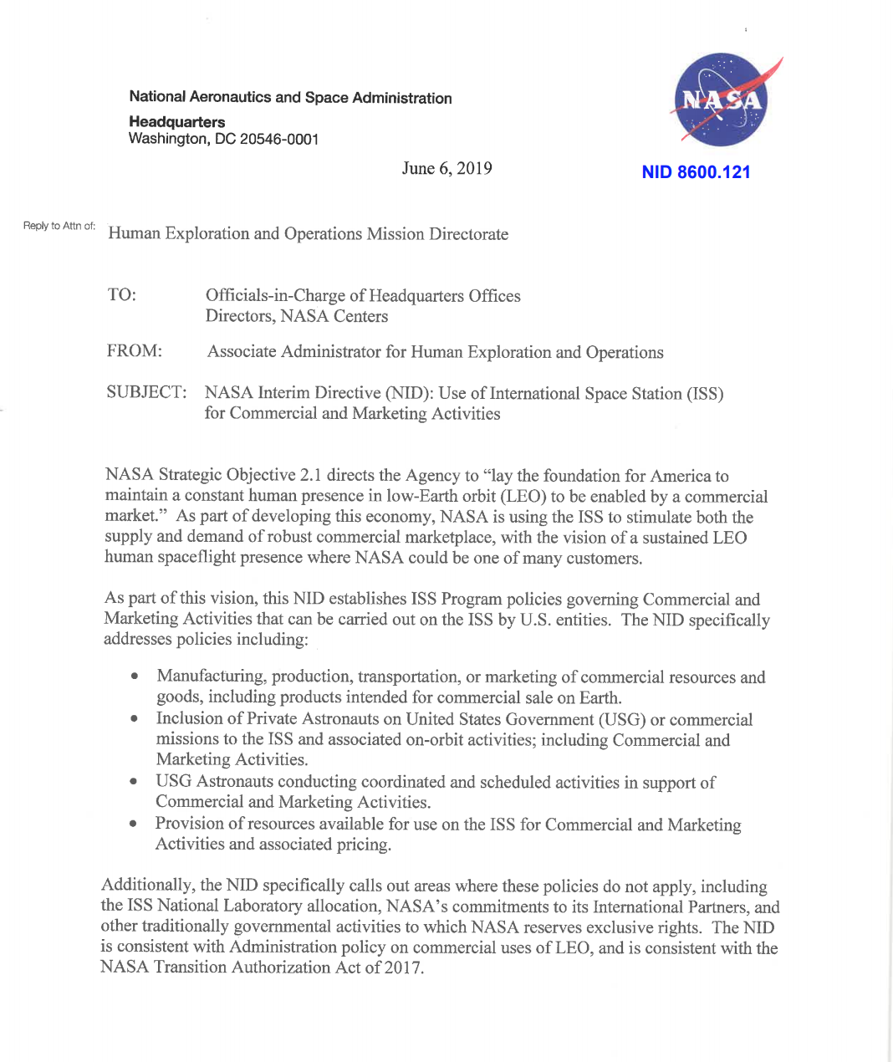
ISS Commercial Use and Pricing Policy
NASA released a NASA Interim Directive (NID) for Use of ISS for Commercial and Promotional Activities
Purpose: to clarify NASA’s policy for expanded commercial use of ISS (within the agency’s existing authorities) consistent with congressional and administration policy direction
Goal: enable commercial activities in low Earth orbit leading to sustainable LEO economy with NASA as one of many customers
Document includes:
Requirements commercial and promotional activities must follow in order to be flown
Pricing of NASA resources (reduced below actual cost to enable market development)
Amount of NASA committed resources for commercial and promotional activities
Limit of resources one commercial entity can acquire at a time

Slide 6
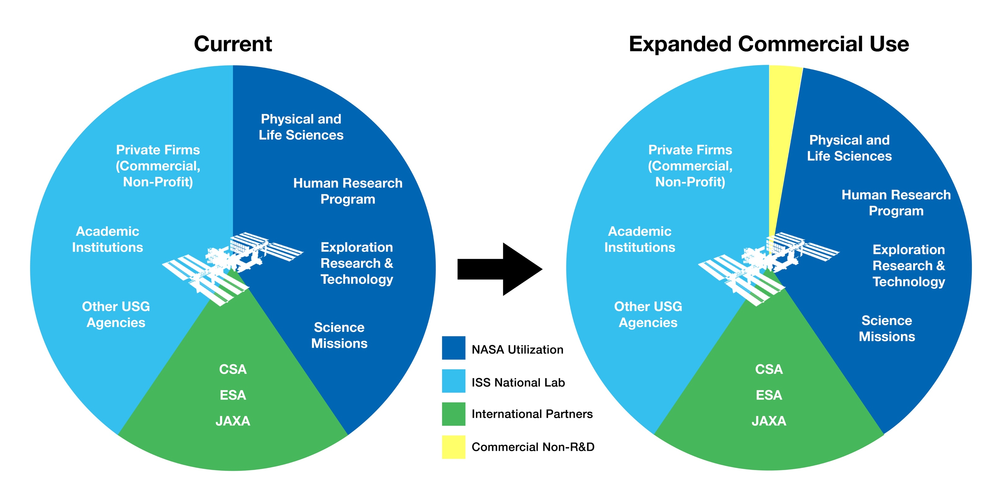
Commercial Resource Allocation
USOS Resources Allocated for Commercial Usage (not to scale)

Slide 7
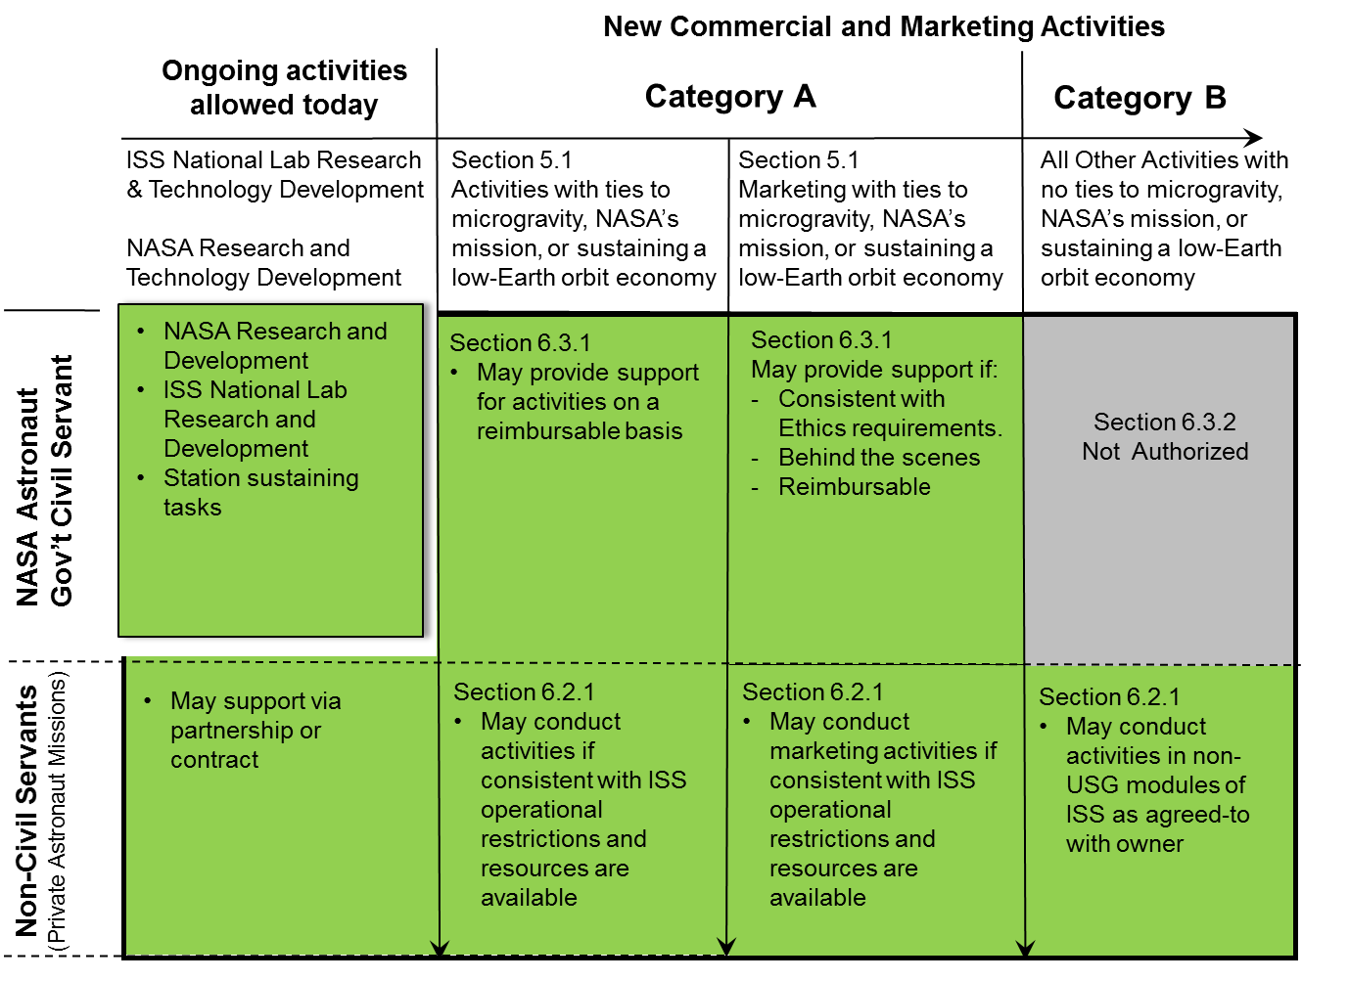
Activities To Be Authorized Under Policy
Notes:
Private Astronauts may conduct advertising and marketing activities in USG elements for commercial applications being developed on ISS due to its microgravity environment, and NASA astronauts may provide behind the scenes crew support for those activities under appropriate reimbursable arrangements, subject to guidance to be developed to ensure compliance with ethical and other applicable regulations or standards.
New legislation would be required for private astronauts to pursue advertising and marketing activities not connected with commercial applications developed in ISS microgravity in USG elements, and to enable NASA Astronauts to provide behind the scenes crew support for such, or to appear in any promotional capacity.
Private Astronauts may conduct such advertising and marketing activities in areas other than USG elements of the ISS, including facilities of the International Partners or Commercial modules (ex: Nanoracks Airlock), as long as such activities also comport with the CCOC, subject to the permission of that partner.

Slide 8
Commercial Activities Pricing Policy
Purpose
Establish prices for ISS resources, enabling companies to reduce uncertainty and develop business plans
Goal
Estimate the market value of ISS resources such as up mass, down mass, trash, crew time, etc., and to enable reimbursement for commercial and marketing activities performed on the ISS (outside the R&D scope of ISS National Lab)
Adjust prices as appropriate, with agility at the speed of industry
Up mass, down mass, trash, and crew time prices waived to below nominal cost to enable market development
Reduced rates will allow partial reimbursement of costs while stimulating potential emerging markets
Limited annual amount one company can acquire to allow multiple opportunities for any given resource

Slide 9
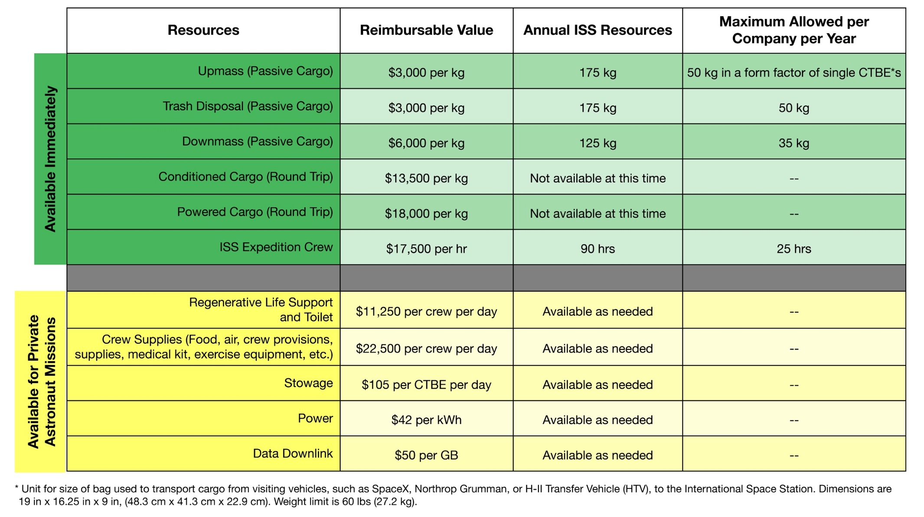
Commercial Pricing Policy for Use of ISS

Slide 10
Private Astronaut Missions
Historical Precedent
Russia sold 8 seats for private astronaut missions of short duration to the ISS between 2001-2009, and has sold 1 seat to UAE for flight in September 2019
Current NASA Plans
NASA is planning to enable private astronaut missions to the ISS using vehicles developed by SpaceX and Boeing under NASA’s commercial crew program (CCP)
All commercial “charter” flight – Commercial Provider sells an entire mission for sortie to ISS
Independent of NASA’s missions under Commercial Crew Program
Initial mission could potentially be as early as late 2020
NASA can accommodate up to 2 ‘sortie’ flights to ISS per year, up to 4 crew per flight, <30 days duration
NASA will encourage foreign governments to work through US companies

Slide 11
LEO Commercial Destinations
NASA Objectives
Partner with US industry to enable development of LEO destinations
Enable purchase of commercial services to meet NASA’s need for continued operations in LEO
Attributes
Destination will not be owned by NASA
Availability of initial services not anticipated for several years
Treat the providers as partners and not suppliers
Minimal NASA oversight (insight only)
Provide maximum flexibility for industry to innovate
Significant non-NASA investment will be required
Significant non-NASA customers required
Minimize industry and investor uncertainty
Early government commitment to purchase commercial services at the destination(s)

Slide 12
Stimulate Sustainable Demand
In-Space Manufacturing Projects underway (funded by ISS to date):
Exotic Optical Fibers (3 projects) - 2 on NG-11 (April 2019), 1 on SpX-16 (December 2018)
Bio-printer - SpX-18 (July 2019)
Industrial Crystallization - NET SpX-20 (March 2020)
Super Alloy Casting - NET NG-12 (October 2019)
Ceramic Stereolithography - NET SpX-19 (December 2019)
New ISS Utilization NRA Focus Areas for new projects leading to scalable, sustainable demand
In-space manufacturing, regenerative medicine/bioengineering, other concepts
Commercial concepts to create “space lab” research capabilities that mirror ground lab capabilities
Intent is to continue building a pipeline of projects, migrating successful projects to commercial destinations(s) in LEO

Slide 13
Stimulate Sustainable Demand
Seeking to understand real and perceived barriers and to address ideas which could stimulate demand (e.g. reducing launch cost, etc.)
Appendix J of the NextSTEP-2 BAA (June 26, 2019)
Seeking to expand pipeline of new entrants into use of LEO destination(s)
Planning to coordinate across microgravity community to simplify user access and reduce barriers
Drop Towers
Parabolic and Suborbital Flights (e.g. Flight Opportunities Program)

Slide 14
Learn more at www.nasa.gov/leo-economy

