Slide 1
JSC Small Business Council Virtual Outreach Event:
Artemis and Beyond
Glenn A. Delgado, Associate Administrator
NASA Office of Small Business Programs
April 21, 2021

Slide 2
NASA Agency FY20
Prime Goals vs. Actual Percentages
Data generated February 22, 2021 from BETA.SAM.GOV

Slide 3
NASA Agency March FY21
Prime Goals vs. Actual Percentages
Data generated April 6, 2021 from BETA.SAM.GOV

Slide 4
FY14-FY20 OSBP Prime and Subcontracting Dollars Trend

Slide 5
FY19-FY20 NASA OSBP Subcategory Trend Analysis

Slide 6
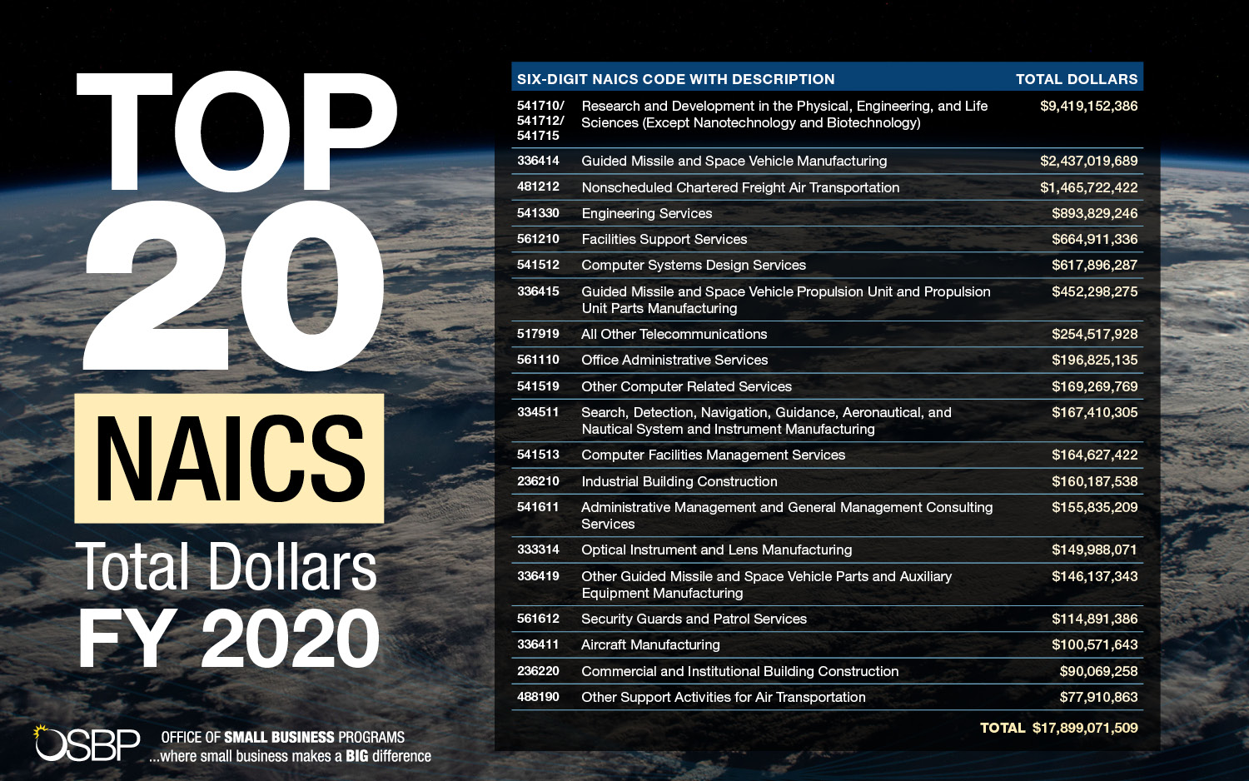

Slide 7
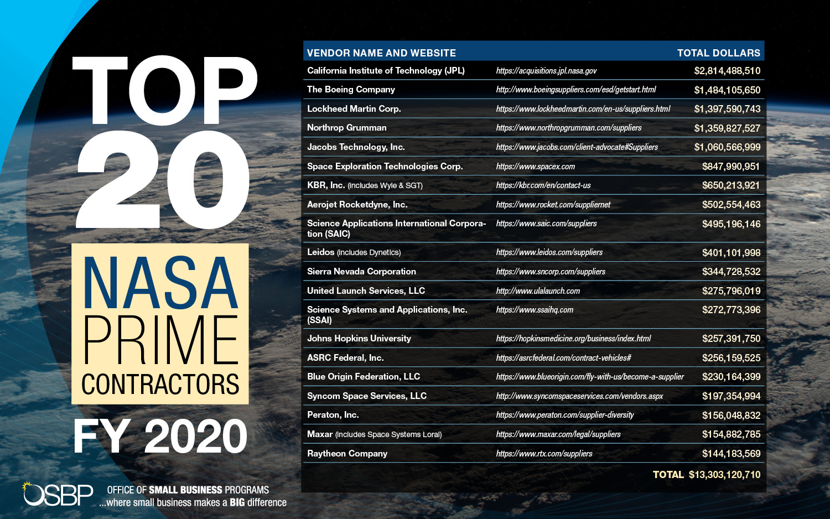
7

Slide 8
ARC FY20
Prime Goals vs. Actual Percentages
Data generated February 22, 2021 from BETA.SAM.GOV

Slide 9
ARC March FY21
Prime Goals vs. Actual Percentages
Data generated April 6, 2021 from BETA.SAM.GOV

Slide 10
AFRC FY20
Prime Goals vs. Actual Percentages
Data generated February 22, 2021 from BETA.SAM.GOV

Slide 11
AFRC March FY21
Prime Goals vs. Actual Percentages
Data generated April 6, 2021 from BETA.SAM.GOV

Slide 12
GRC FY20
Prime Goals vs. Actual Percentages
Data generated February 22, 2021 from BETA.SAM.GOV

Slide 13
GRC March FY21
Prime Goals vs. Actual Percentages
Data generated April 6, 2021 from BETA.SAM.GOV

Slide 14
GSFC/HQ FY20
Prime Goals vs. Actual Percentages
Data generated February 22, 2021 from BETA.SAM.GOV

Slide 15
GSFC/HQ March FY21
Prime Goals vs. Actual Percentages
Data generated April 6, 2021 from BETA.SAM.GOV

Slide 16
JSC FY20
Prime Goals vs. Actual Percentages
Data generated February 22, 2021 from BETA.SAM.GOV

Slide 17
JSC March FY21
Prime Goals vs. Actual Percentages
Data generated April 6, 2021 from BETA.SAM.GOV

Slide 18
KSC FY20
Prime Goals vs. Actual Percentages
Data generated February 22, 2021 from BETA.SAM.GOV

Slide 19
KSC March FY21
Prime Goals vs. Actual Percentages
Data generated April 6, 2021 from BETA.SAM.GOV

Slide 20
LaRC FY20
Prime Goals vs. Actual Percentages
Data generated February 4, 2021 from BETA.SAM.GOV

Slide 21
LaRC March FY21
Prime Goals vs. Actual Percentages
Data generated April 6, 2021 from BETA.SAM.GOV

Slide 22
MSFC FY20
Prime Goals vs. Actual Percentages
Data generated February 22, 2021 from BETA.SAM.GOV

Slide 23
MSFC March FY21
Prime Goals vs. Actual Percentages
Data generated April 6, 2021 from BETA.SAM.GOV

Slide 24
NSSC FY20
Prime Goals vs. Actual Percentages
Data generated February 22, 2021 from BETA.SAM.GOV

Slide 25
NSSC March FY21
Prime Goals vs. Actual Percentages
Data generated April 6, 2021 from BETA.SAM.GOV

Slide 26
SSC FY20
Prime Goals vs. Actual Percentages
Data generated February 22, 2021 from BETA.SAM.GOV

Slide 27
SSC March FY21
Prime Goals vs. Actual Percentages
Data generated April 6, 2021 from BETA.SAM.GOV

Slide 28
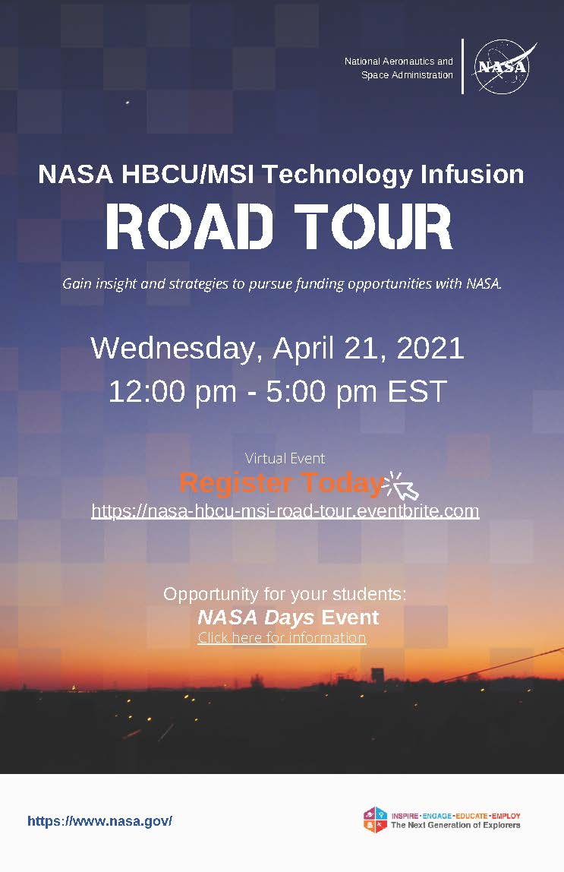
Upcoming NASA OSBP Education and Outreach Opportunities
NASA HBCU/MSI Technology Infusion Road Tour
  April 21, 2021
  12:00pm ET – 5:00pm ET
  For more information: https://nasa-hbcu-msi-road-tour.eventbrite.com/

Slide 29
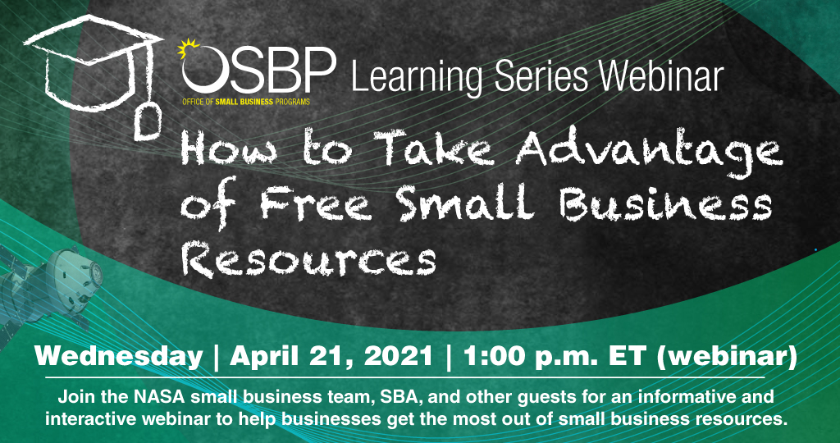
Upcoming NASA OSBP Education and Outreach Opportunities
OSBP Learning Series
  1:00pm ET, monthly on 3rd Wednesday
  For more information: https://osbp.nasa.gov/knowledge-portal.html

Slide 30
Upcoming NASA OSBP Education and Outreach Opportunities
Artemis Supplier and Northeastern Pennsylvania Small Business Industry Day
  May 2021 (TBD)
  For more information: https://osbp.nasa.gov/regional-outreach-events.html
Pacific Northwest Aerospace Defense Conference
  June 10, 2021
  For more information: https://osbp.nasa.gov/regional-outreach-events.html

Slide 31
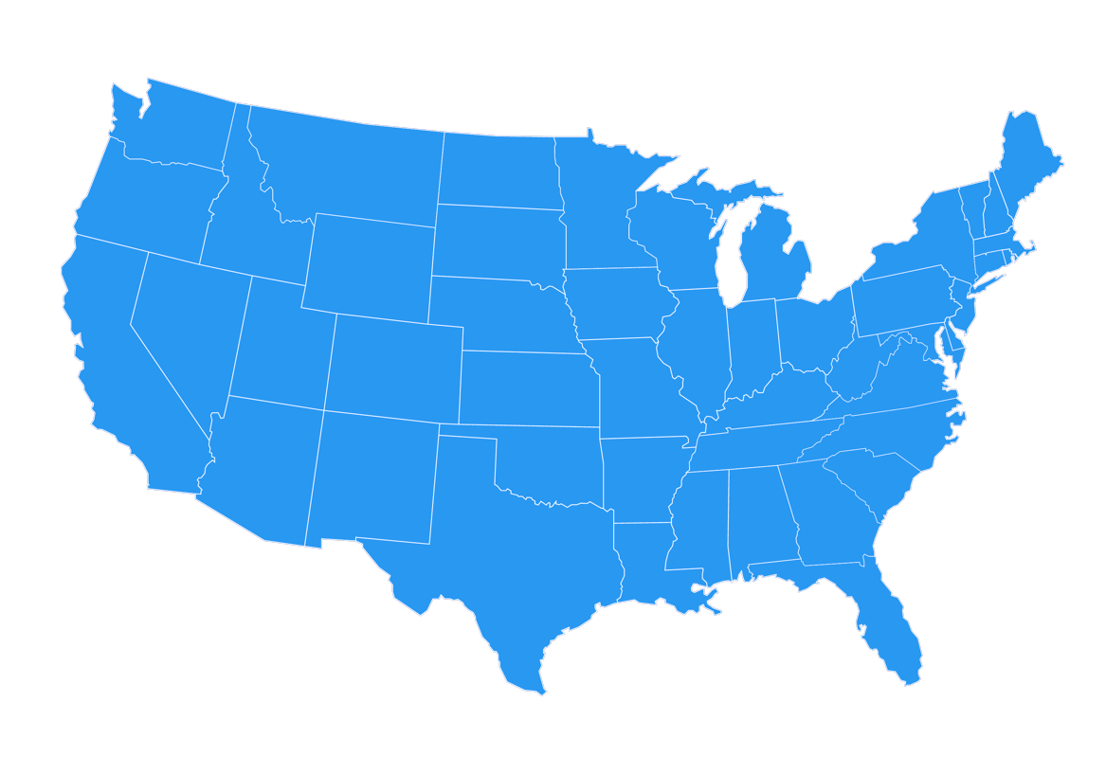




















NASA Small Business Specialists Around the Country
Ames Research Center
Aerospace and Small Spacecraft
Moffett Field, CA
Armstrong Flight Research Center
Atmospheric Research and Testing
Edwards, CA
Christine L. Munroe
Glenn Research Center
Aeronautics and
Spacecraft Technology
Cleveland, OH
Eunice J. Adams-Sipp
Goddard Space Flight Center
Science Missions and Telescopes
Greenbelt, MD
Jennifer D. Perez
Sholainka O. Martyn
Kandace P. Chappell
Djaataa Onanuga
Jet Propulsion Laboratory
Deep Space Robotic Rovers
and Networks
Pasadena, CA
Charles E. Bray, Jr.
Mary Helen Ruiz
Matthew B. Christian
Tara A. Every
Anna N. Hovano
Langley Research Center
Aviation and Space Research
Hampton, VA
Robert O. Betts
Johnson Space Center
Human Space Flight Operations
Houston, TX
NASA Shared Services Center
Agency Contract Support
Bay St. Louis, MS
Troy E. Miller
Stennis Space Center
Vehicle Engine Testing
Bay St. Louis, MS
Kay S. Doane
Kennedy Space Center
Space Vehicle Launch and Landing
Cape Canaveral, FL
Joyce C. McDowell
Natalie B. Colvin
.
Robert E. Watts
Monica F. Craft
Tumarrow Romain
Marshall Space Flight Center
Space Transportation, Propulsion Systems, Space Systems, and Science
Huntsville, AL
David E. Brock

Slide 32
Connect with OSBP at www.osbp.nasa.gov or smallbusiness@nasa.gov
Social Media
OSBP Website
OSBP Mobile App
OSBP Learning Series Webinars
Small Business Outreach Events

Slide 33

Questions?

